Slide 1
TEAD Talk – The Pursuit of a Treatment and Cure for EHE
The Hippo Pathway, TEAD, EHE, and drug development

Slide 2
About the speaker
Ph.D. in biochemistry (1996) – University of Wisconsin, Madison
Conducted research on signaling pathways
Day job: patent attorney working with academics and companies on a wide range of technologies, with significant experience in cancer diagnostics and therapeutics
Chairman of the Board of Directors of a cancer therapeutics company developing ways to make immunotherapies work more effectively and work on more types of cancers
Board of Directors – The EHE Foundation

Slide 3
Disclaimers:
I am not a world-expert on these scientific topics. The world experts (Dr. Rubin, Dr. Pobbati, and others) thankfully make their time and expertise available to the EHE community.
The goal is to help provide a more understandable overview of the topic. In doing so, we’ll be using some imprecise words and images that do not fully capture the nuance and complexity that exists.
We will be talking about drugs and clinical trials. None of this is medical advice. Please consult with your physicians in deciding what therapies to take and if and whether to join clinical trials.

Slide 4
Topics
Background on biological pathways
The Hippo pathway and TEAD
Why is it important for EHE?
Drugs in development
Drug development processes

Slide 5
Pathways
What are pathways?
Pathways are the way that information and instructions are transferred within the body
Understanding pathways allows us to figure out how to control the information flow to change things: for example, to turn off or change instructions in the body that cause cancer or that allow cancer to survive or spread

Slide 6
Pathways
Information is transferred in the body through a series of interactions between different molecules (“messengers”)
Information molecule
Run or fight!
I hear you. I’ll pass on the message to make energy
Adrenaline
Messenger

Slide 7
Pathways
A “pathway” is made up of this collection of messengers each handing off information to the next to deliver the information to where it needs to go
Turn on the energy generation systems!
Run or fight!
Adrenaline
Release sugar as fuel!
Messenger 1
Messenger 2
Sugar releasing molecule
Sugar

Slide 8
Messages
Examples of famous messengers (hormones):
Adrenaline: “increase blood flow, breathing, and energy generation”
Insulin: “use sugar to make energy
Estrogen: “generate an egg”
Testosterone: “produce sperm”

Slide 9
Pathways gone wrong
Type 1 diabetes: the body (pancreas) makes little to no insulin so the instruction “use sugar to make energy” does not get communicated to cells, causing blood sugar to get too high
BRAF pathway: “hey cell: grow and divide normally”
BRAF mutation: “cell: DIVIDE! DIVIDE! DIVIDE! ” (melanoma and other cancers)
HIPPO pathway: “hey cell: time to stop growing”
EHE: cells divide out of control because the Hippo message “stop growing” fails
We’ll come back to this in detail

Slide 10
Understanding how information flows
An imperfect, but hopefully helpful, analogy: the mail/post
A letter or package that conveys a message (“happy birthday,” “happy holidays,” “I was thinking of you”) is sent from one person to another through a series of intervening people (“messengers”) and places
Things can happen to the message along the way causing it to not arrive or to show up at the wrong location
Different types of messages may have good or bad impacts and we may want to do things to encourage or stop certain types of messages (junk mail!)

Slide 11
Understanding how information flows
Simple?

Slide 12
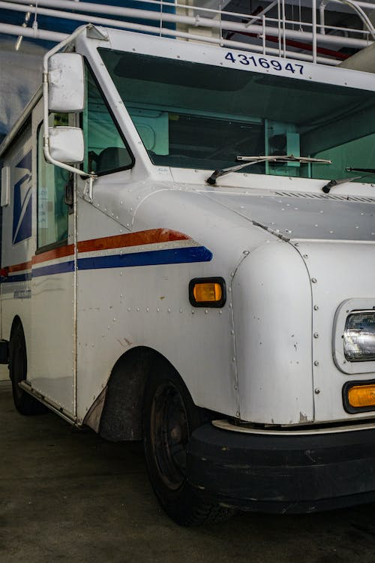
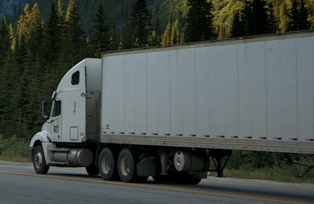
No! It is complex

Slide 13
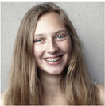
The nature of the “information” can affect the outcome

Slide 14
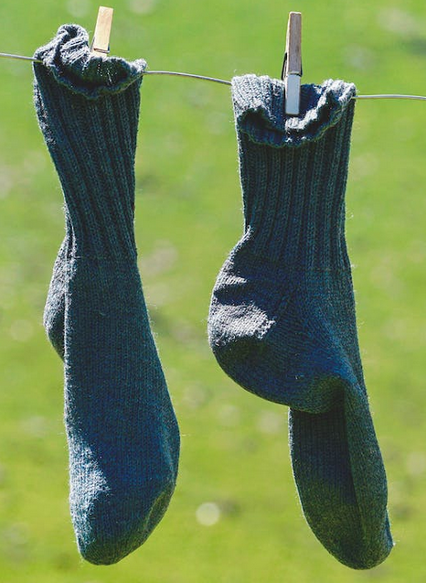
If “bad information” is sent, can have a bad result

Slide 15
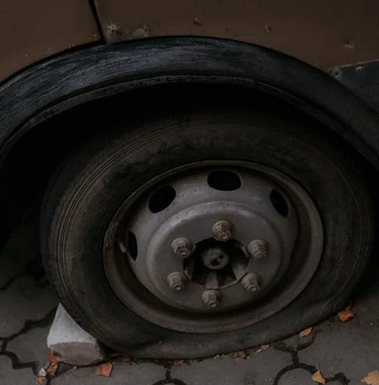
Events can inhibit (delay or stop) the flow

Slide 16
Understanding the process creates ways to intervene
Hold
delivery
order
Text: “Don’t send socks!”
Hijack
Package swap

Slide 17
Cells
Cell
Nucleus
Nuclear
membrane
DNA
Cell membrane

Slide 18
Cell pathways – simple?
Insulin
Use sugar to produce energy
Simple?

Slide 19
No! It is complex

Slide 20
Generic pathway
An information molecule reaches a cell and comes into contact with a receptor.
The receptor spans the cell membrane allowing the information from outside of the cell to be transmitted into the cell.
The receptor passes on the information to a signal transduction molecule.
The signal transduction molecule passes the information to other molecules such as i) another signal transduction molecule, ii) an enzyme, or iii) a transcription factor (tf)
A transcription factor activates or deactivates genes
Info
Receptor
Signal transduction
tf
Enzyme

Slide 21
How is the information actually communicated?
A messenger chemically modifies the next molecule
Acts like a key being put into an ignition or lock – changing the next messenger from an “off” to an “on” status (or vice versa)
The modification changes the shape, changing its behavior
P
P
Signal transduction
Signal transduction
Inactive
enzyme
Active
enzyme

Slide 22
Knowledge is power!
If scientists can figure out how the pathways work, solutions to the problems can be identified.
Is there a missing messenger?
If so, artificially add a messenger (example – synthetic insulin)
Or trick the body into making one
Is an incorrect message being delivered?
If so, get rid of the bad messenger
Or prevent the bad message from getting delivered (many cancer drugs)

Slide 23
The Hippo Pathway
Some background and history
Also known as the Salvador-Warts-Hippo (SWH) pathway
A signaling pathway that controls organ size in animals through the regulation of cell proliferation and regulated cell death
The message it delivers: “stop growing”
Its name comes from one of its signaling components—the Hippo (Hpo) protein
Mutations in this gene lead to tissue overgrowth, or a "hippopotamus"-like effect
The pathway was discovered in the study of fruit flies
Hippo (Hpo) protein is a fruit fly name – the similar protein in humans and other mammals is called MST1/2 (or STK3/4)

Slide 24
Hippo normal versus hippo mutant fruit fly
https://bpod.mrc.ac.uk/archive/2014/4/11

Slide 25
Hippo pathway: TEAD
TEAD
TEAD = Transcriptional enhanced
associate domain
TEAD describes a group of “transcription factors” that, when activated, turn on genes involved in cell growth
There are four known types in humans TEAD1, TEAD2, TEAD3, and TEAD4
If TEAD is too active, the cell can become a cancer cell
TEAD

Slide 26
Hippo pathway: YAP/TAZ
YAP/TAZ
YAP = yes-associated protein
TAZ = transcriptional coactivator
with PDZ-binding motif
YAP/TAZ (TAZ also known as WWTR1), is a “transcriptional co-activator” that activates TEAD by delivering a “grow” message to TEAD
YAP/TAZ
Grow
TEAD

Slide 27
Hippo pathway: LATS1/2
LATS1/2
Stop
LATS = large tumor suppressor
LATS1/2
LATS1/2 are “signal transduction” proteins that communicate a “stop growing” message to YAP/TAZ by modifying YAP/TAZ
When the stop growing message is delivered, YAP/TAZ is prevented from entering the nucleus and talking to TEAD
YAP/TAZ
Grow
TEAD
I don’t hear anything, so I’m just going to chill out

Slide 28
Hippo pathway: 14-3-3
14-3-3
Stop
LATS1/2
14-3-3 = 14-3-3
14-3-3 are regulatory proteins that bind to YAP/TAZ if YAP/TAZ has been modified by LATS1/2. The binding of 14-3-3 to YAP/TAZ prevents YAP/TAZ from going into the nucleus and activating TEAD.
Grow
YAP/TAZ
14-3-3
TEAD
I don’t hear anything, so I’m just going to chill out
Shush, you are staying here

Slide 29
Hippo pathway: MST1/2
MST1/2
Stop
MST1/2
Stop
LATS1/2
MST = macrophage stimulating
MST1 and MST2 are signal transduction proteins that are the “Hippo” of the Hippo pathway. They communicate the message “stop growing” by modifying LATS1/2.
Grow
YAP/TAZ
14-3-3
TEAD
I don’t hear anything, so I’m just going to chill out
Shush, you are staying here

Slide 30
Messengers in the Hippo pathway
There are some other messengers involved as well, but they won’t be focused on here.
SAV1 (binds to MST1/2 helping them do their thing)
MOB1 (binds to LATS1/2 helping them do their thing)

Slide 31
Hippo pathway is off: growing mode
1. YAP/TAZ has not been given the “stop growing” message from LATS1/2 and therefore has traveled into the nucleus and activated TEAD.
2. TEAD is bound to DNA, activating genes involved in cell growth.
3. MST1/2, LATS1/2, and 14-3-3 are chilling out not doing anything.
4. The cell is growing normally.
MST1/2
LATS1/2
YAP/TAZ
Grow
14-3-3
TEAD

Slide 32
Hippo pathway is on: “stop growing” mode
1. MST1/2 delivers a “stop growing message” to LATS1/2.
2. LATS1/2 delivers the “stop growing message” to YAP/TAZ.
3. YAP/TAZ, having been modified by LATS1/2, is bound by 14-3-3, preventing YAP/TAZ from going into the nucleus and delivering the “grow” message to TEAD.
4. TEAD does not receive the “grow” message from YAP/TAZ and does not activate genes involved in cell growth.
5. Cell growth is stopped and/or cell death instructions are initiated.
Stop
MST1/2
Stop
LATS1/2
Grow
YAP/TAZ
14-3-3
TEAD
I don’t hear anything, so I’m just going to chill out
Shush, you are staying here

Slide 33
How is this relevant to EHE?
?

Slide 34
EHE: the “stop growing” message fails
In EHE, the “grow” message gets sent to TEAD even if the Hippo pathway “stop growing” message is being sent.
Without the “stop growing” message, the cell grows out of control (cancer).
How does this happen?

Slide 35
EHE: what happens to the messaging?
The mutations associated with EHE make new messengers that delivers a “grow” message to TEAD.
EHE involves a gene fusion: TAZ-CAMTA1 or YAP-TFE3
These gene fusions make new Frankenstein proteins that are part Taz or Yap (which can bind to TEAD) and part new thing
Compared to YAP/TAZ, they do some things similarly: they travel into the nucleus, they bind to TEAD, and they deliver a “grow” message to TEAD
But they do some things differently: they don’t listen to the “stop growing” message of the Hippo pathway
TAZ/CAMTA
YAP-TFE3
or

Slide 36
Hippo pathway is on: but EHE ignores it
Stop
TAZ/CAMTA, acting like YAP/TAZ, travels to the nucleus and delivers a “grow” message to TEAD. This happens even if the Hippo pathway is on. TAZ/CAMTA (or YAP-TFE3) does not listen to the “stop.”
The cell grows out of control. It gets a “grow” message because the Hippo “stop growing” message doesn’t stop EHE’s TAZ/CAMTA (or YAP-TFE3).
MST1/2
Stop
LATS1/2
TAZ/CAMTA
14-3-3
TAZ/CAMTA
Grow
I don’t see anyone to shush
TEAD

Slide 37
Understanding the process creates ways to intervene
Hold
delivery
order
Text: “Don’t send socks!”
Hijack
Package swap

Slide 38
How can the problem be fixed?
Goal: prevent TAZ/CAMTA from delivering a “grow” message to TEAD
Several different ways this might be accomplished
Option 1: Prevent TAZ/CAMTA from being made (“Don’t send socks” text)
The bad message never gets made/sent
Option 2: Destroy TAZ/CAMTA before it gets to TEAD (Hijack approach)
Option 3: Get TAZ/CAMTA to respond to the Hippo “stop growing message” or a similar message (Hold delivery approach)
Option 4: Prevent TAZ/CAMTA from talking to TEAD (take the socks out of the mail)
Option 5: Shut down other pathways involved in cell growth (mTOR pathway – e.g., Sirolimus)
Backup Option: Deal with the cells that have gotten the wrong message (deal with the unhappy kid that received socks)
Chemo, immunotherapy, surgery, transplant, ablation, etc.

Slide 39
Prevent TAZ/CAMTA from talking to TEAD
YAP/TAZ, TAZ/CAMTA, and YAP-TFE “talk” to TEAD by binding to TEAD.
If the binding can be prevented, TEAD won’t “hear” the undesired “grow” message.
TAZ/CAMTA
TEAD
TAZ/CAMTA
TEAD

Slide 40
TEAD Inhibitors
No PPID
An “inhibitor” is a substance that slows or stops the activity of something else
A TEAD inhibitor slows or stops TEAD from doing its thing (slows or stops TEAD from activating genes that cause cell growth)
There is a type of inhibitor called a “protein-protein interaction disruptor” (PPID) that binds to a protein (such as TEAD) and disrupts its ability to interact with another protein (such as TAZ or YAP)
TAZ/CAMTA
Grow
TEAD
OK
With PPID
TAZ/CAMTA
Grow
PPID
What?
TEAD

Slide 41
TEAD inhibitor fixes the broken Hippo pathway
Ignoring the Hippo “stop” message, TAZ/CAMTA travels to the nucleus and tries to deliver a “grow” message to TEAD.
The inhibitor prevents TEAD from hearing the TAZ/CAMTA “grow” message. The EHE cell stops growing and/or dies.
Stop
MST1/2
Stop
LATS1/2
TAZ/CAMTA
TAZ/CAMTA
14-3-3
Grow
I don’t see anyone to shush
PPID
What?
TEAD

Slide 42
Zooming in
TEAD is not a red rectangle.
YAP/TAZ interacts with TEAD at multiple locations (interfaces) on the surface of TEAD. Inhibitors that bind an interface can block the “grow” message from getting to TEAD.
A central pocket (red) in TEAD is important for its ability to work. Inhibitors that bind the central pocket block the “grow” message from getting to TEAD.
From Pobbati and Rubin, Molecules 2020, 25, 6001

Slide 43
Inhibitor drug considerations: efficacy
How well does it block the TAZ/CAMTA or YAP-TFE3 “grow” message from being heard by TEAD?
There are no perfect inhibitors. Some work better than others.
Does it get to all of the EHE cells?
How well does it get into the EHE cells and get to TEAD?
Does it inhibit the right TEADs?
TEAD 4 is a good EHE target (Tanas et al., Oncogene, 35(7):929-938 (2016))
Can EHE cells adapt over time to ignore the inhibitor?

Slide 44
Inhibitor drug considerations: Toxicity
Does the inhibitor inhibit other things in the body?
Does the inhibitor damage any organs (liver? heart? kidney?)
TEADs do important things in the body – ideally don’t want to shut them all down permanently
Do we want the inhibitor to inhibit all TEAD types (TEAD1, TEAD2, TEAD3, TEAD4) or just some of them?
Is there a way to block TEAD from interacting with TAZ/CAMTA or YAP-TFE3, but would otherwise leave it alone (wouldn’t interfere with YAP/TAZ talking to TEAD)

Slide 45
Inhibitor drug considerations: Commercial
If the drug is super-specific for EHE, will anyone be willing to pay for its commercial development?
Drug development is incredibly expensive (hundreds of millions to billions of dollars)
The Hippo pathway and TEADs are involved in many different cancer types
This has made TEAD inhibitors an attractive commercial target for multiple different groups

Slide 46
Drug development pathway
Basic research: developing animal models, cell lines, test methods
Drug discovery: testing candidate drugs against the models and cell lines to identify drugs that work
Drug libraries
Repurposed drugs
Rational design
Preclinical research: optimizing the drug, confirming safety and efficacy in animals
Clinical research: conducting safety and efficacy experiments in humans
Post-clinical research: monitoring drug performance after approval

Slide 47
Many inhibitors in the pipeline
Entity | Drug | TEAD interaction | Comments
Ikena Oncology | IK-930 | Lipid pocket | TEAD1-specific inhibitor in phase 1 FDA trial (EHE included)
Novartis | IAG933 | Surface | Inhibitor against all 4 TEADs in phase 1 FDA trial (EHE included)
Vivace Therap. | VT3989 | Lipid pocket | Inhibitor of TEAD modification by YAP in phase 1 FDA trial
Betta Pharma. | BPI-460372 | Lipid pocket | Inhibitor of TEAD modification by YAP; trials starting
Sanofi/Kyowa | K-975 | Lipid pocket | Inhibitor against all 4 TEADs in preclinical development
Suzhou Gen. | GH658 | Lipid pocket | Preclinical development
Bridgene Biosci. | BGI-9004 |  | Inhibitor against all 4 TEADs in preclinical development
Sporos Biodisc. | SPR1-0117 |  | TEAD1- and TEAD4-specific inhibitor in preclinical development
And others

Slide 48
The regulatory process (United States)
FDA (U.S. Food and Drug Administration) communications typical start during preclinical research
When sufficient preclinical research is completed, an application is submitted to the FDA to begin human testing
IND = Investigational New Drug

Slide 49
FDA phases
Phase I
Safety and dosing (typically 20-100 people; several months)
Phase II
Side effects and efficacy (typically several hundred people; several months to multiple years)
Phase III
Efficacy and adverse reactions (typically several hundred to thousands of people; 1-4 years)
Request for data review and drug approval submitted
NDA (small molecule) = New Drug Application
BLA (biologics) = Biologic License Application

Slide 50
Participating in trials
There are often very complicated eligibility criteria
Age, type of cancer, stage of disease, previous treatment history, transplant status, other medical conditions, . . .
Phase I
Many patients will receive a non-optimal dose (often too low)
Often limited geographic location(s)
Phase II/III
Patients are typically separated into test groups (that receive the new drug) or control groups (that receive standard of care, but not the new drug)
Will all of the costs be covered?

Slide 51
Orphan drugs
A drug "intended for the treatment, prevention or diagnosis of a rare disease or condition, which is one that affects less than 200,000 persons in the US . . .“
Tax credits for qualified clinical trials
Exemption from user fees
Potential seven years of market exclusivity after approval

Slide 52
Accelerated Approval Program
Allow for earlier approval of drugs that treat serious conditions, and fill an unmet medical need based on a surrogate endpoint
A surrogate endpoint is a marker, such as a laboratory measurement, radiographic image, physical sign or other measure that is thought to predict clinical benefit but is not itself a measure of clinical benefit
The use of a surrogate endpoint can considerably shorten the time required prior to receiving FDA approval (by years)
Must go on to seek a traditional approval (drug is withdrawn if fails)
Many cancer drugs have used this process

Slide 53
Off label use of drugs
From the FDA perspective, once the FDA approves a drug, healthcare providers generally may prescribe the drug for an unapproved use when they judge that it is medically appropriate for their patient
Often used for rare disease where there may never be an FDA trial
May be issues with insurance coverage

Slide 54
Compassionate use
Use of an unapproved drug that has a proven safety profile (typical Phase III drugs, sometimes Phase II drugs) for an individual
Typically done when there are no other options for a patient, or the patient could not meet the FDA trial requirements
An individual IND is filed and can move forward if the sponsor company, FDA, and IRB (review board at the institute where the trial is occurring) all agree

